Slide 1
Analytic Trigonometry
Barnett Ziegler Bylean

Slide 2
Chapter 6
Additional Triangle Ratios

Slide 3
Ch 6 - section 1
Law of sines

Slide 4
Deriving the law of sines
Any triangle can be split into 2 right triangles by dropping an altitude from one vertex to the base opposite
sin($α)=\frac{h}{b}$ $\sin\left(β\right)= \frac{h}{a}$
With a little algebra $\frac{sin⁡(α)}{a}=\frac{sin⁡(β)}{b}$
By rotating the triangle to a different base you can also get $\frac{sin⁡(α)}{a}=\frac{sin⁡(γ)}{c}= \frac{sin⁡(β)}{b}$
b
a
h
$$α$$
$$β$$

Slide 5
Using the law of sines to find measurements
Given an angle , a side, and a second angle (the side between the angles) (ASA)
Find the 2nd and 3rd sides
The missing angle that is opposite the known side is 105⁰
45⁰
30⁰
55in

Slide 6
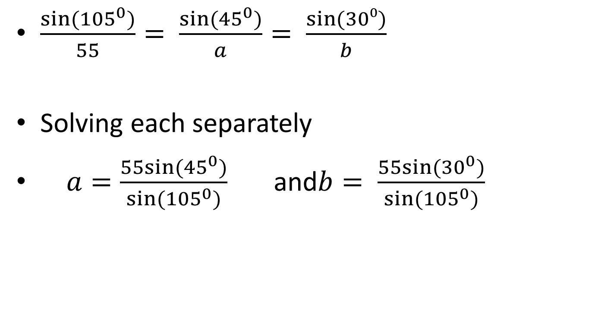
By law of sines
$\frac{sin⁡({105}^{0})}{55}= \frac{sin⁡({45}^{0})}{a}= \frac{\sin{(30⁰)}}{b}$
Solving each separately
$a=\frac{55sin⁡({45}^{0})}{sin⁡({105}^{0})}$ and$b= \frac{55sin⁡({30}^{0})}{sin⁡({105}^{0})}$

Slide 7
Another example
Similarly given 2 angles and the side Not between them (AAS)
By law of sines
$\frac{sin⁡({40}^{0})}{42}= \frac{sin⁡({80}^{0})}{x}= \frac{sin⁡(?)}{y}$
42ft
80 $⁰$
40 $⁰$

Slide 8
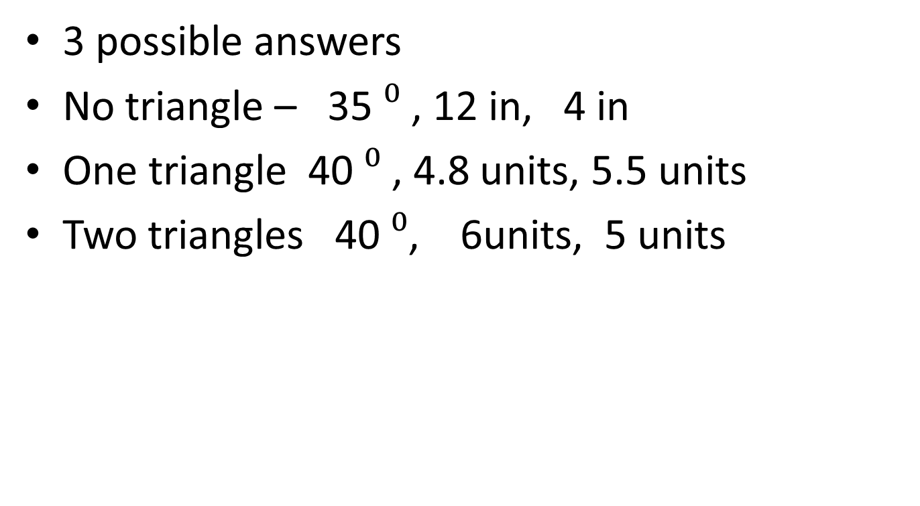
Angle side side
3 possible answers
No triangle – 35 $⁰$ , 12 in, 4 in
One triangle 40 $⁰$ , 4.8 units, 5.5 units
Two triangles 40 $⁰$, 6units, 5 units

Slide 9
Assignment
p361(5-50 odd, 57-78 odd)

Slide 10
Chapter 6 – section 2
Law of cosines

Slide 11
Given side angle side (SAS)
Law of sines won’t work –
given 5 in 42 $⁰$ and 8 in
$\frac{sin⁡(α)}{5}= \frac{sin⁡({42}^{0})}{b}= \frac{sin⁡(γ)}{8}$

Slide 12
Law of cosines
$a^{2}=b^{2}+ c^{2}−2bc cos\left(α\right)$
given 5 in 42 $⁰$ and 8 in
$a^{2}=5^{2}+8^{2} −2\left(5\right)\left(8\right)\cos\left(42°\right)$
Now you can use law of sines to find the other measures

Slide 13
Given side side side
Again law of sines is useless
8 in, 12 in, 17 in
First verify that you have a triangle
a + b > c (triangle inequality)
$8^{2}={12}^{2}+{17}^{2}−2\left(12\right)\left(17\right)cos⁡(α)$

Slide 14
assignment
P372(5-42odd,51-69)

